Slide 1
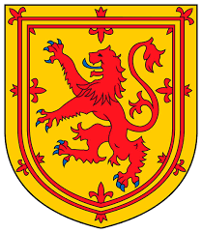
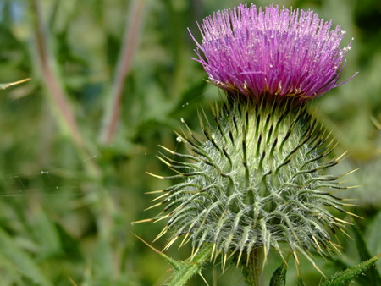
Symbols

Slide 2
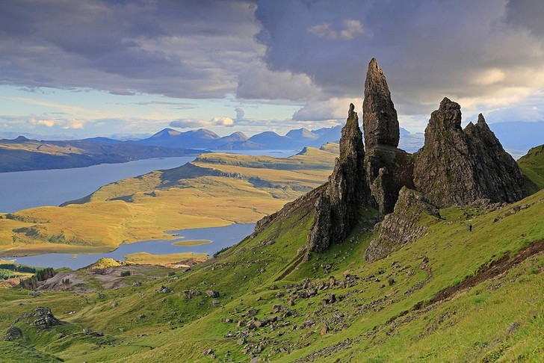
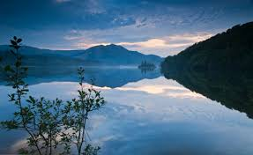
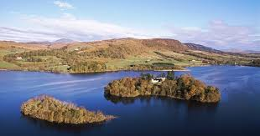
Nature

Slide 3
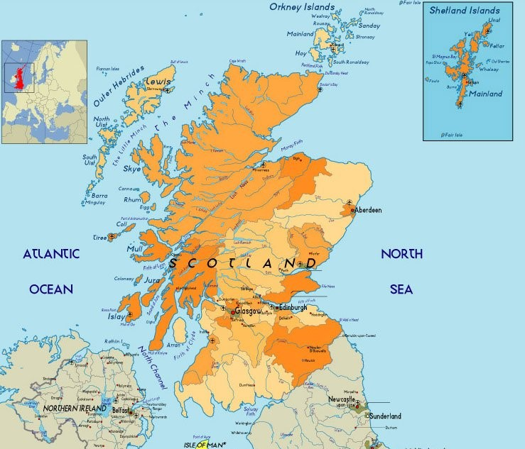
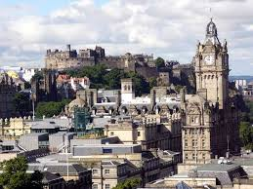
Geographical position and the capital

Slide 4
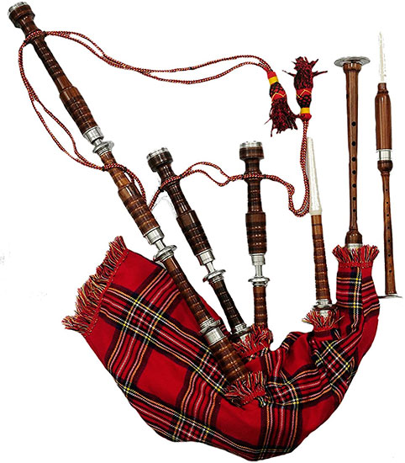
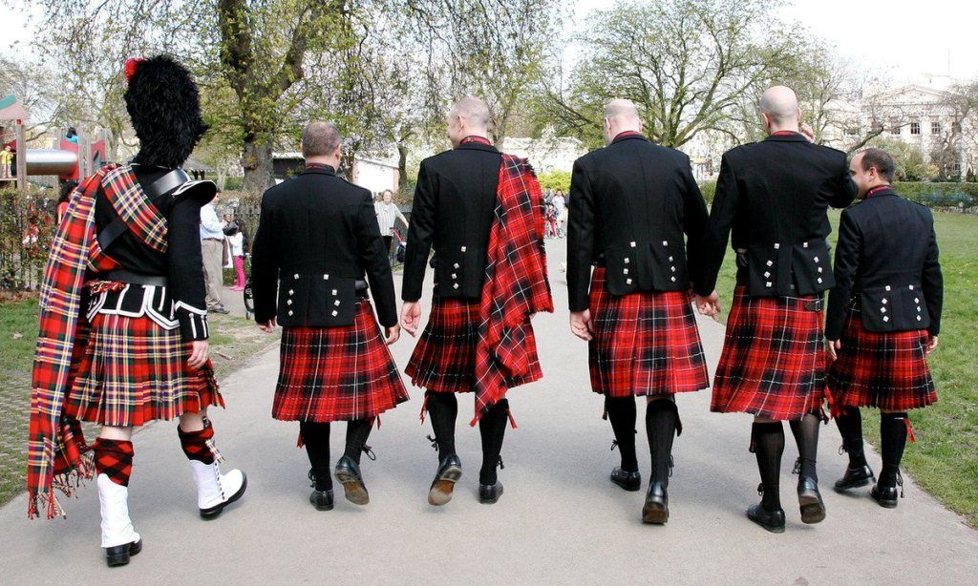
Traditions

Slide 5
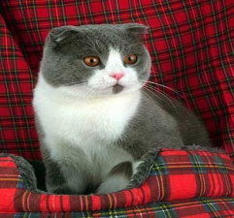
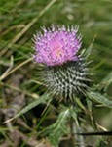
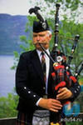
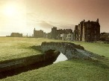
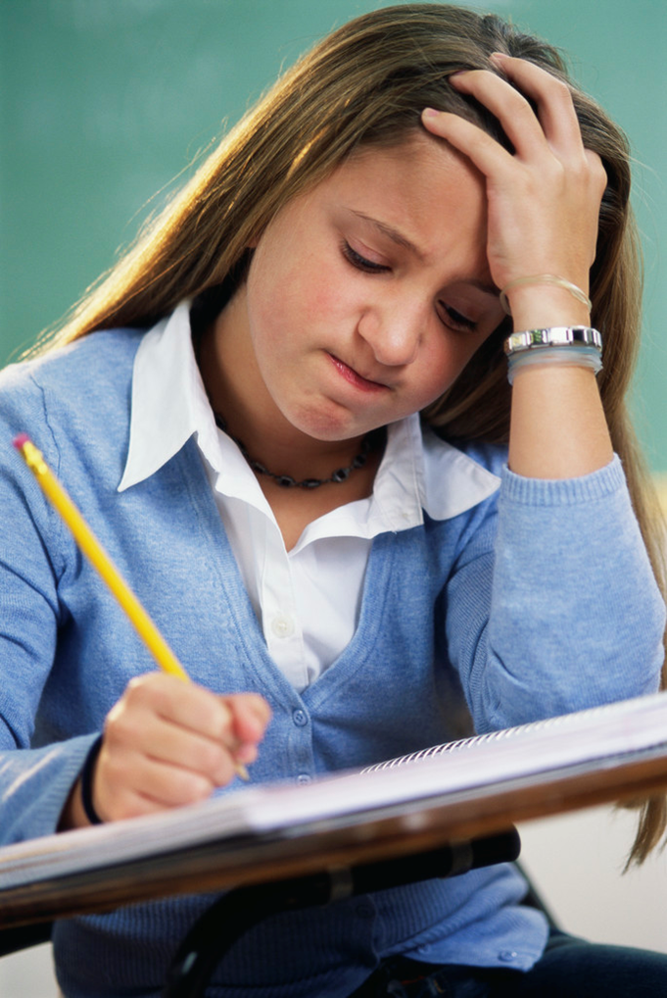
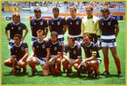
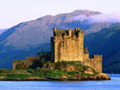
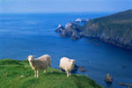
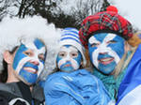
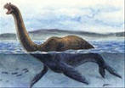
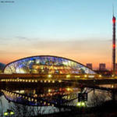
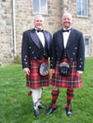
Scotland

Slide 6
Match the word with the picture
The mountains
The coat of arms
a thistle
a bagpipe
the kilt

Slide 7
The tasks are …
To learn about Scotland (from the text)
To present the information to the class (CLASTER)

Slide 8
will learn and tell about symbols of Scotland
will learn and speak about nature of Scotland
will learn and tell about the geographical position and a capital of Scotland
will learn and tell about traditions of Scotland.

Slide 9
The tasks are:
To learn about Scotland (from the text)
Read the text, choose the info, complete the Claster with the info.
To present the information to the class (CLASTER)

Slide 10
Reflection
For me, it was easy to …
For me, it was interesting to …
For me, it was difficult to …
Work in a group, read the text, choose the information, complete the claster

Slide 11
Homework
Найти информацию об известных людях Шотландии, популярном виде спорта, известных городах Шотландии.

