Slide 1
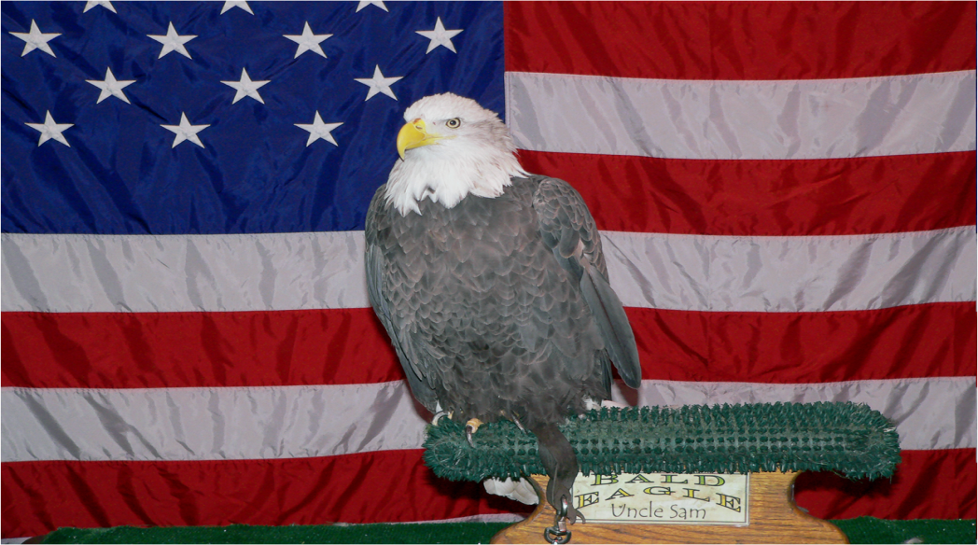
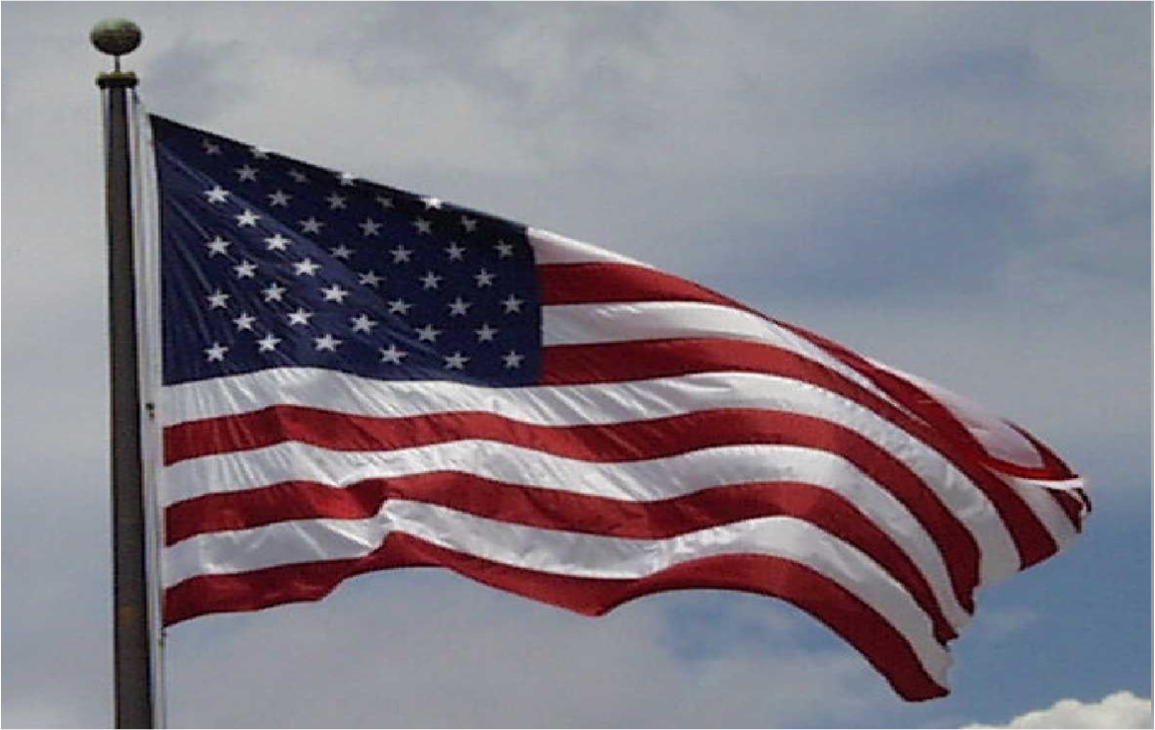
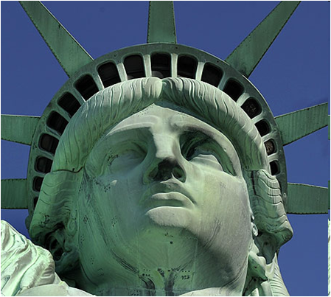
Symbols of America
The national anthem

Slide 2
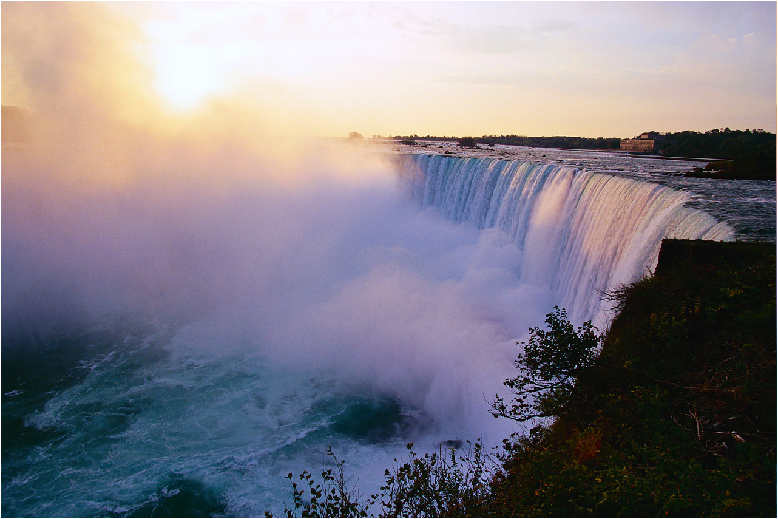
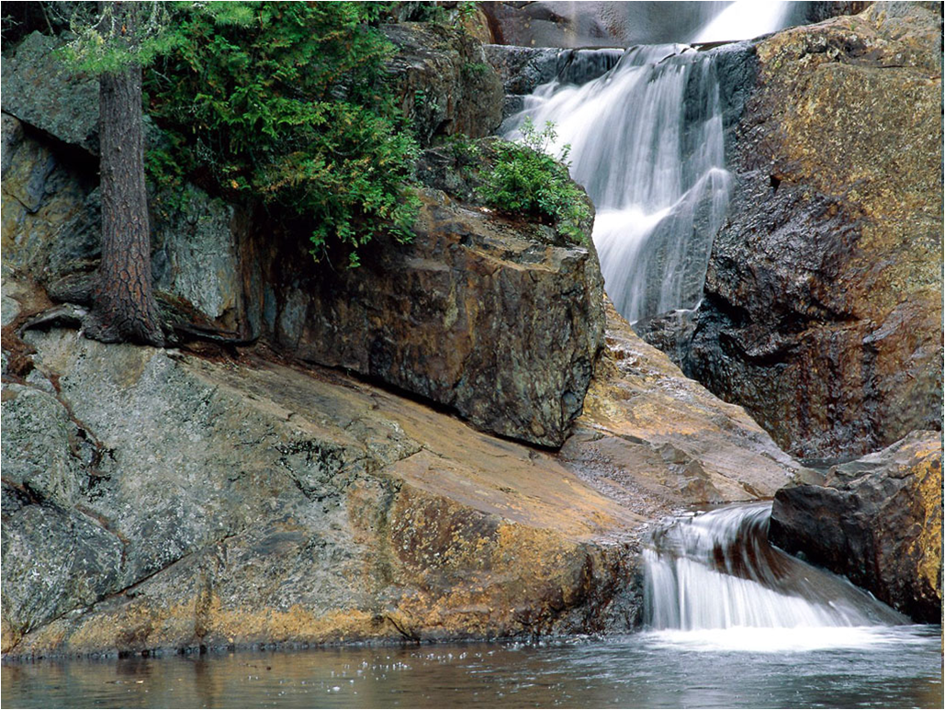
Nature

Slide 3
The Capital

Slide 4
Russia
The double headed eagle
The Arctic, the Atlantic and the Pacific Ocean
Long, bitter winters
Red Square
The three colored flag
The Urals

Slide 5
The test about Russia
INDEPENDENCE DAY IN RUSSIA IS CELEBRATED IN :
A) OCTOBER
B) NOVEMBER
C) JUNE
THE HERMITAGE IS SITUATED IN:
A) MOSCOW
B) ST. RETERSBURG
C) SUZDAL
THE RUSSIAN HEAD OF THE STATE IS:
A) TSAR
B) PRESIDENT
C) PRIME MINISTER
THE RUSSIAN COAT OF ARMS HAS :
A) TWO- HEADED EAGLE
B) TWO CROWNS
C) TWO CROSSES
THE RUSSIAN FLAG CONSISTS OF … STRIPES.
THREE
FOUR
FIVE
MOSCOW WAS FOUNDED BY … IN …
IVAN III IN 1500
DOLGORUKIY IN 1147
PETER THE GREAT IN 1100

Slide 6
Check yourself
1. – C
2. - B
3. – B
4. – A
5. – A
6. – B

Slide 7
Some tasks for the text
1. To read the text and to give titles to each paragraph.
2. To complete the sentences with the information from the text.
3.To present your knowledge about Russia.

Slide 8
Russia at a glance
IT IS THE LARGEST COUNTRY IN THE WORLD.
RUSSIA CONSISTS OF EUROPE AND ASIA.
THE COUNTRY IS WASHED BY 12 SEAS AND 3 OCEANS : THE PACIFIC, THE ARCTIC AND THE ATLANTIC.
ITS TOTAL AREA IS OVER 17 MILLION SQUARE KILOMETRES.

Slide 9
Symbols

Slide 10
Nature and climate

Slide 11
Rivers, mountains and lakes

Slide 12
The capital

Slide 13
Famous Places

