Slide 1
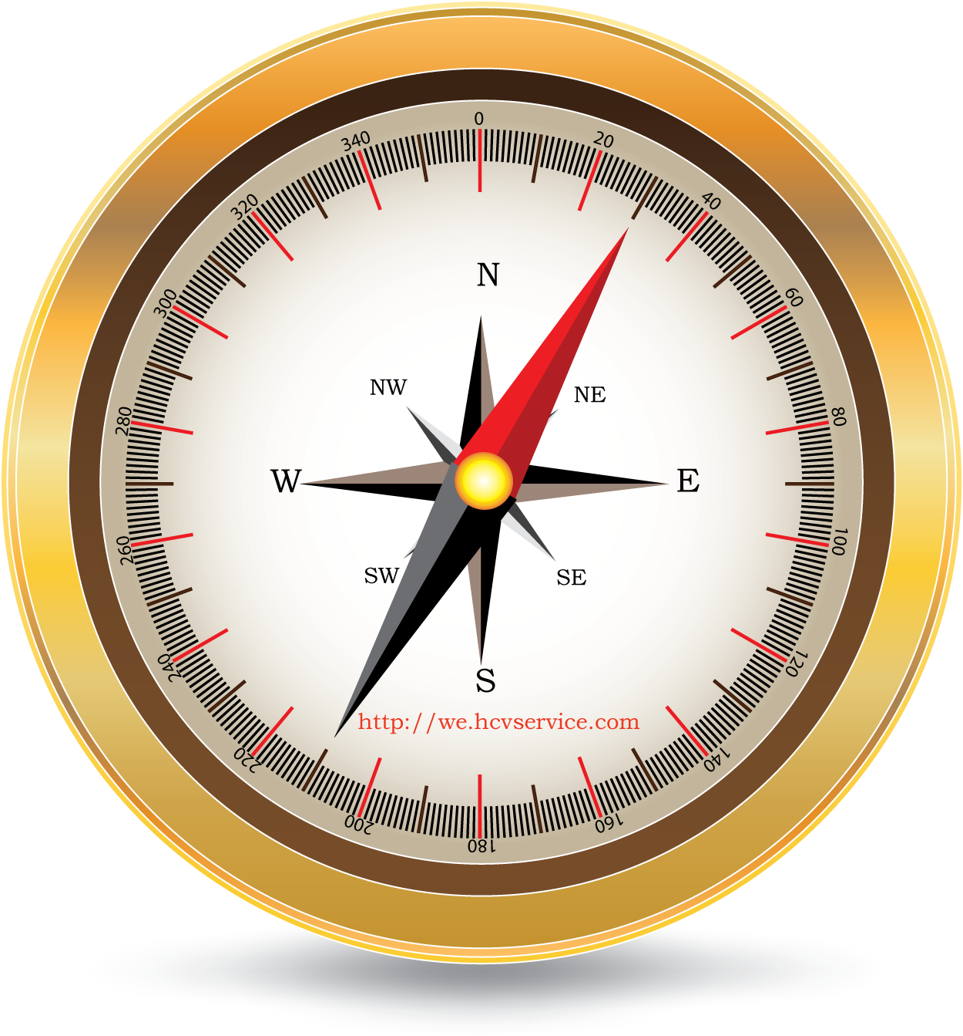
The 5th form

Slide 2
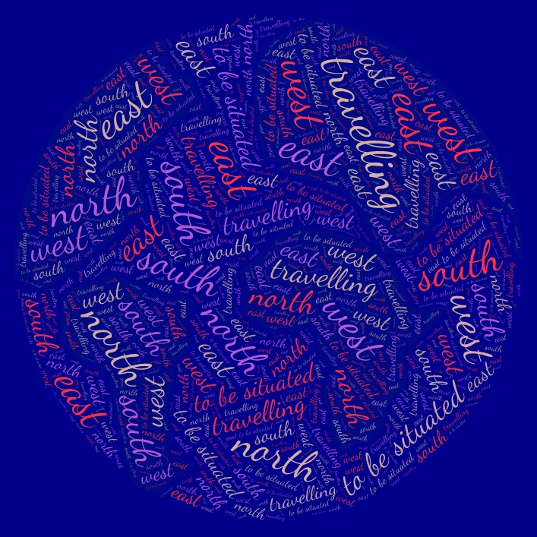

Slide 3
The topic is…..
TRAVELLING

Slide 4
The tasks:
1. To learn how to read the new words and their meanings (cards)
2. To remember them (game)
3. To remember how to write them correctly (test)

Slide 5
To learn how to read the new words and their meanings
You should:
1) Take a tablet
2) Find “Quizzlet” on the table
3) Click on “Quzzlet” and find the topic “TRAVELLING”
4) Click on it and find “cards”
5) Learn how to read the new words and their meanings

Slide 6
To remember them (game)
You should:
1) Find the unit “подбор” and play a game
2) Remember your time

Slide 7
To remember how to write them correctly (test)
You should:
1) Find “test” and do the tasks
2) Try to get as many points as you can

